Slide 1



Smart Irrigation System

Slide 2

Contents
Objective
Components
Block Diagram
Circuit Diagram
Working
Result

Slide 3
Objective
The objective of a smart irrigation system is to conserve water and promote efficient watering practices by utilizing technology, real-time data, and automation. These systems aim to optimize irrigation schedules based on factors like soil moisture levels, weather forecasts, and plant requirements, preventing overwatering and reducing water wastage. This leads to water conservation, cost savings, and healthier plant growth while minimizing environmental impact.

Slide 4
Components
NodeMCU
Soil Moisture Sensor Module
Relay Module
Submersible pump
Breadboard
Connecting Wires
Arduino IDE
Blynk
IFTTT

Slide 5
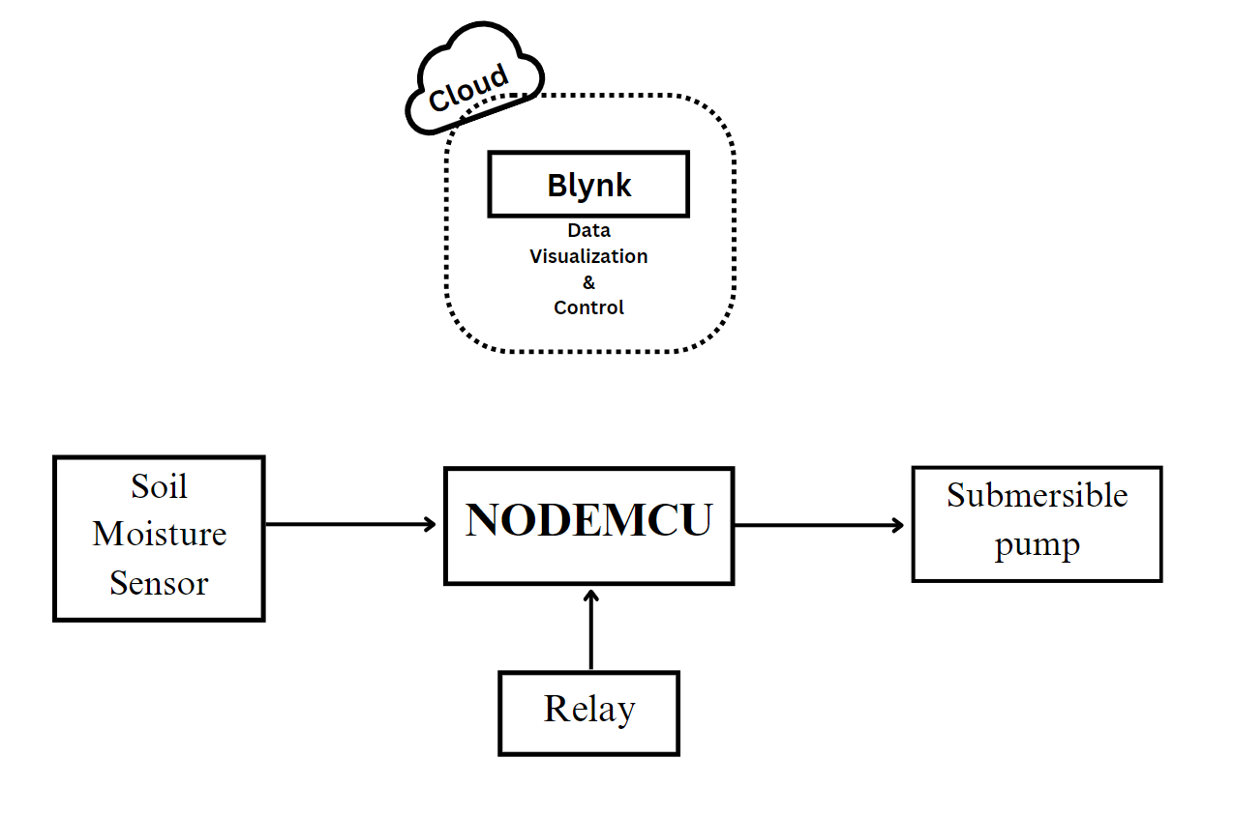
Block Diagram

Slide 6
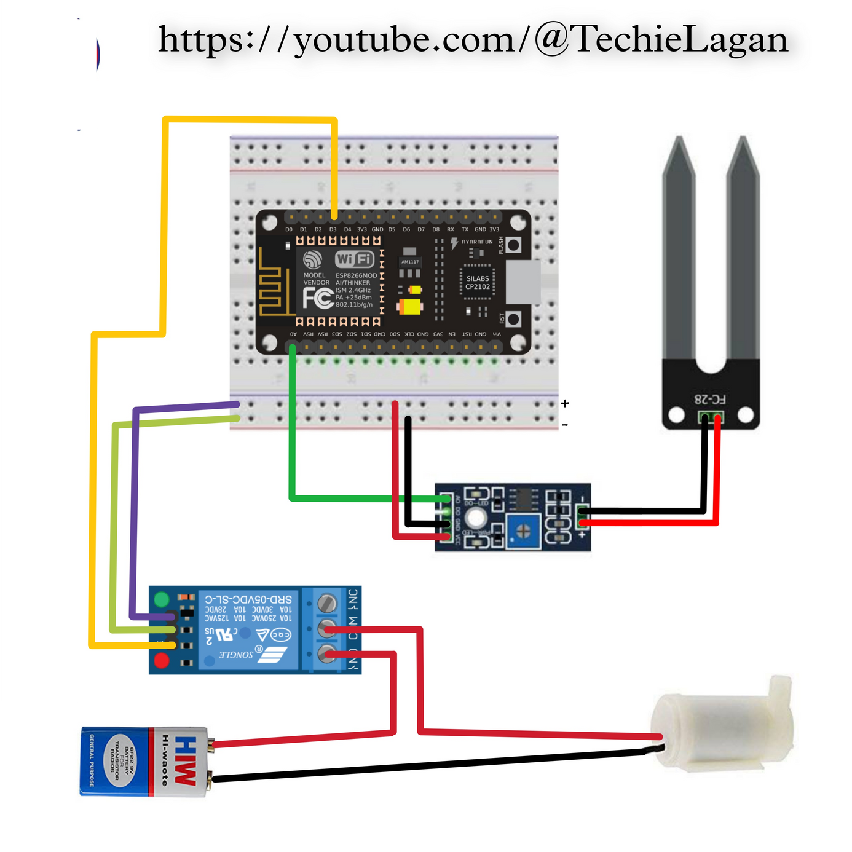
Circuit Diagram

Slide 7

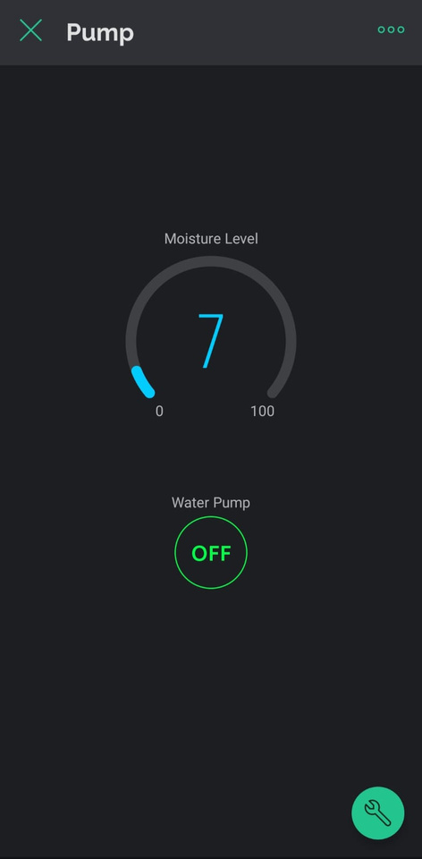
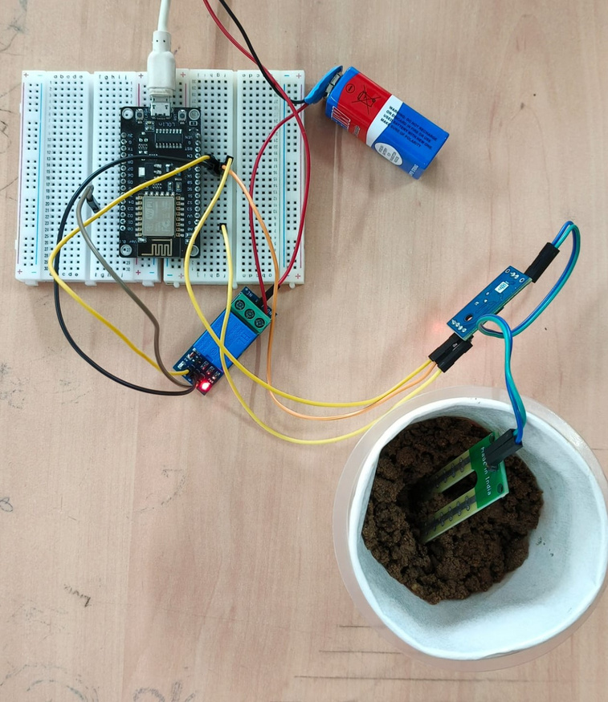
Result
When Moisture content is Less

Slide 8
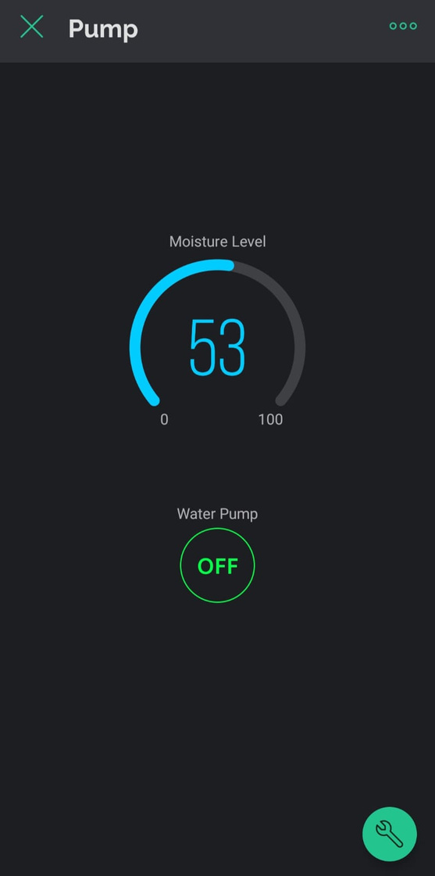
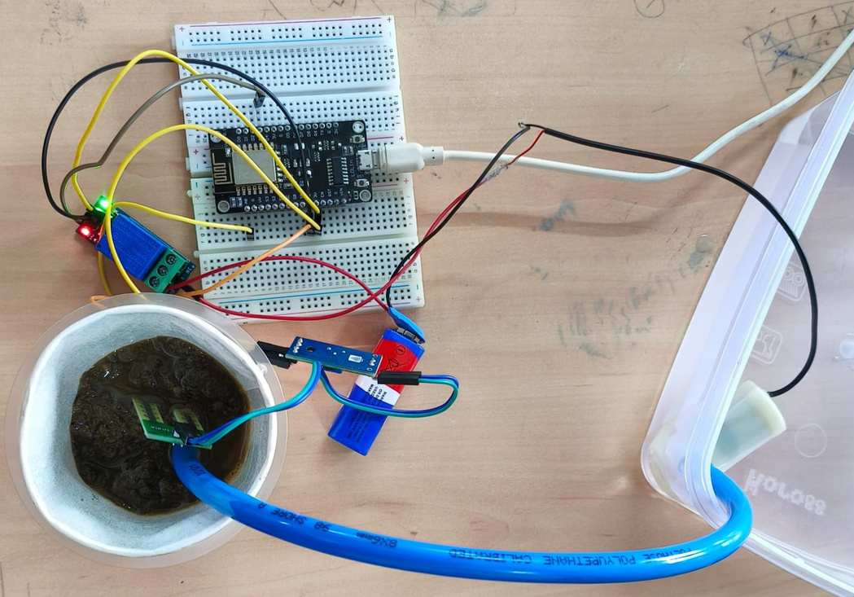
When Moisture content is More

Slide 9
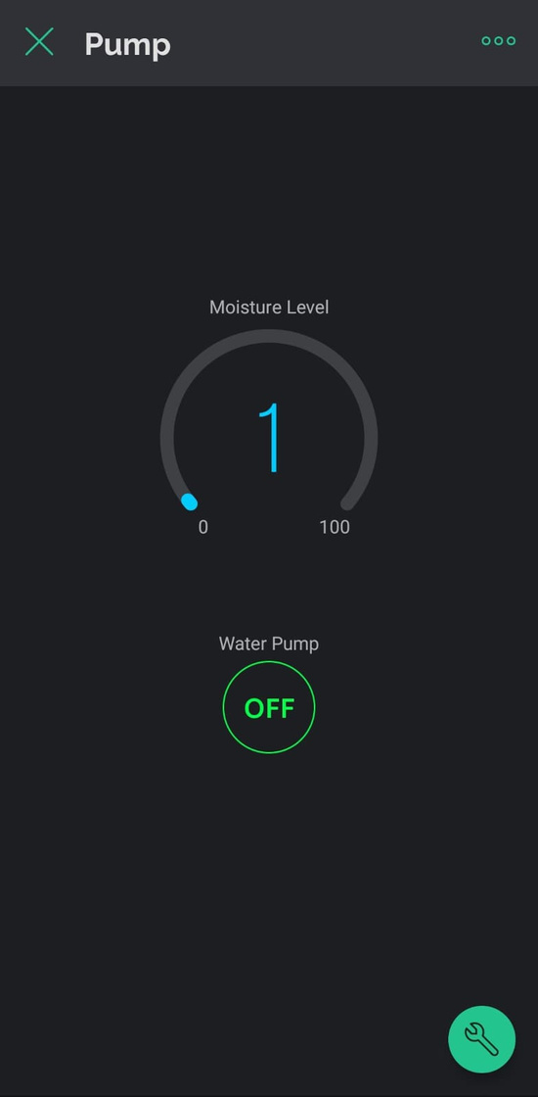
Phone Interface

Slide 10
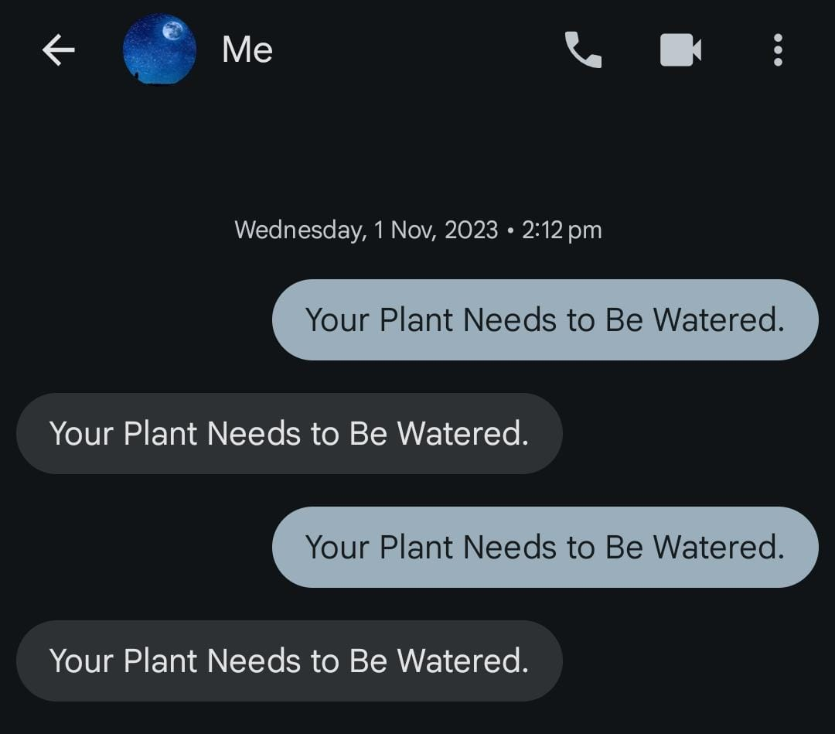
SMS Notification Alert

Slide 11
Thank you!

